Slide 1




PERSONAWISE AI
TEAM : TECHNO-TOUCH
TEAM MEMBERS :
Laxmi Sarki
Diksha Kewat
Preeti Tiwari

Slide 2

Problem Statement

Slide 3
Challenges : Credit Score is not enough ?
Lack of transparency:
Difficult to understand how their score is calculate which leads to confusion/ mistrust in financial institutions.
Negligence of relevant factors:
Over-reliant on credit history neglects alternative data sources such as payment history for utilities or rental agreements.
Individuals without established credit histories (e.g., young adults) face significant barriers in obtaining credit.
Inaccuracy in scoring :
Reliant on outdated data (Fails to account for recent changes in income, employment, or expenses.)

Slide 4
Challenges : So many Financial Advices !!!
Generic Recommendations
Many financial advisors provide one-size-fits-all advice, failing to consider unique user situations.
This approach can lead to poor financial decisions based on incomplete understanding.
Limited Personalization
Lack of tools to analyze individual circumstances (e.g., spending habits, financial goals) for tailored advice.
Users often do not receive actionable steps aligned with their specific financial situations.

Slide 5

Solution Inspiration

Slide 6

Credit score hai!!!

Slide 7
Building User’s Financial Persona
Using Alternate Data Sources
Prompt-Based Real-Time Updates
Transparency in Scoring
Creditworthiness
Solution
Tailored Recommendations
Education and Empowerment
Financial Advisory

Slide 8
Creditworthiness
Building User’s Financial Persona
Comprehensive data collection from demographics, income, expenses, assets, and liabilities.
Reflects user-specific financial situations and behaviors.
Using Alternate Data Sources
Incorporates non-traditional data (utility payments, rental history) to provide a more inclusive view of financial health.
Helps assess creditworthiness for users with limited credit histories.

Slide 9
Creditworthiness
Prompt-Based Real-Time Updates
Interactive user engagement through prompts for updated information.
Ensures up-to-date and accurate financial personas for personalized advice and credit assessments.
Transparency in Scoring
Offers a clear breakdown of credit scoring for users.
Provides actionable insights for improving credit scores, building trust through transparency.

Slide 10
Financial Advisory
Tailored Recommendations
Utilizes AI to analyze user data and deliver customized financial advice based on unique financial situations, goals, and preferences.
Offers actionable steps that align with users' financial objectives, enhancing decision-making.
Education and Empowerment
Provides access to educational resources to enhance financial literacy, helping users make informed decisions.
Regular updates and insights keep users informed about the financial landscape and potential opportunities.

Slide 11
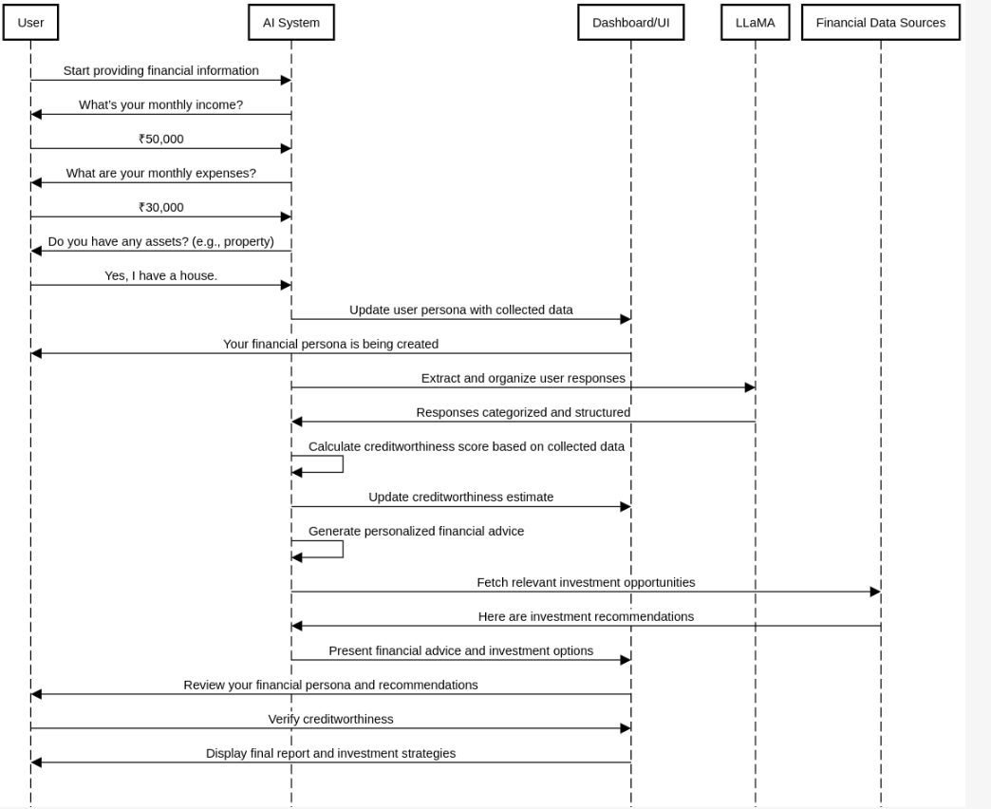
PersonaWiseAI Sequence:

Slide 12
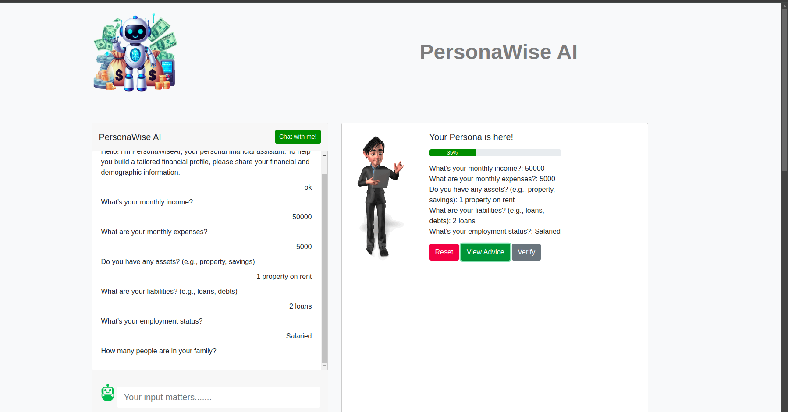
Building User’s Financial Persona:

Slide 13
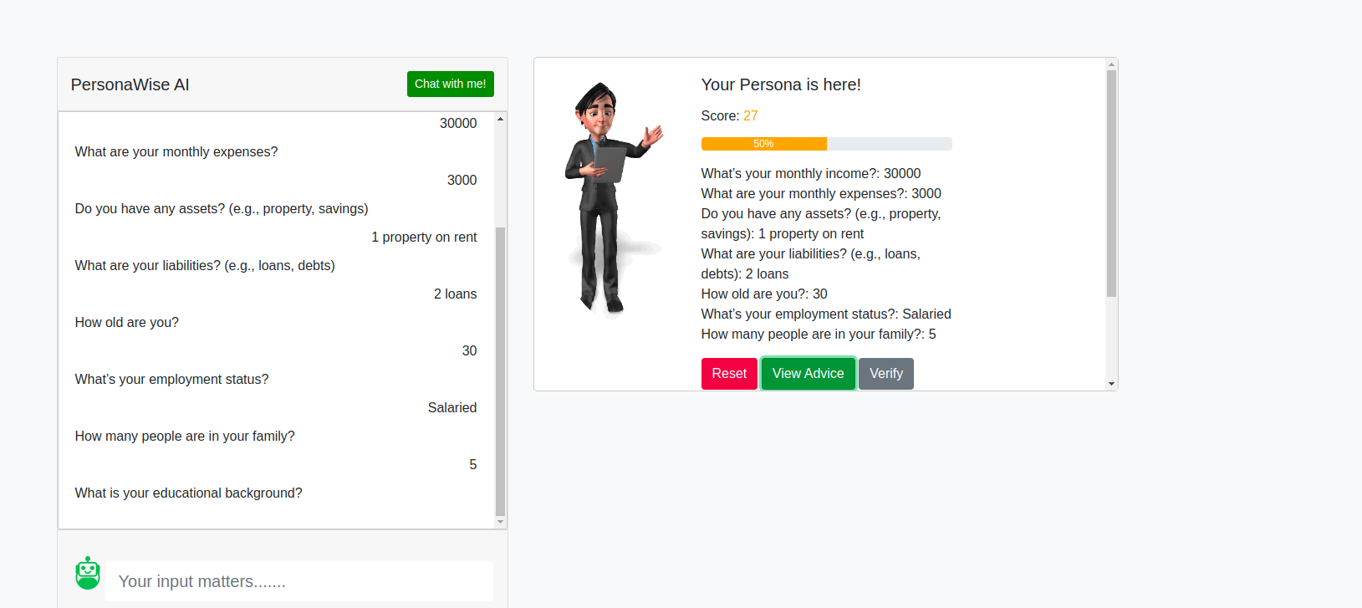
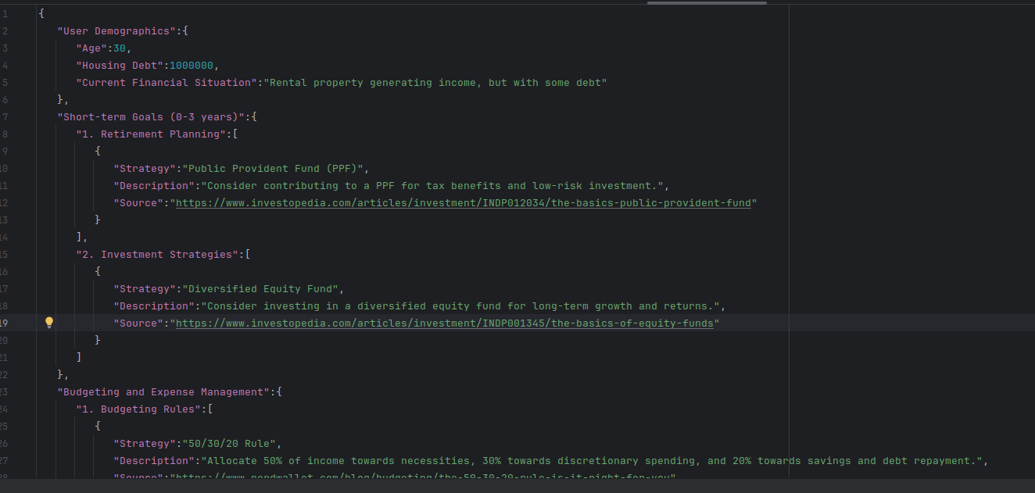
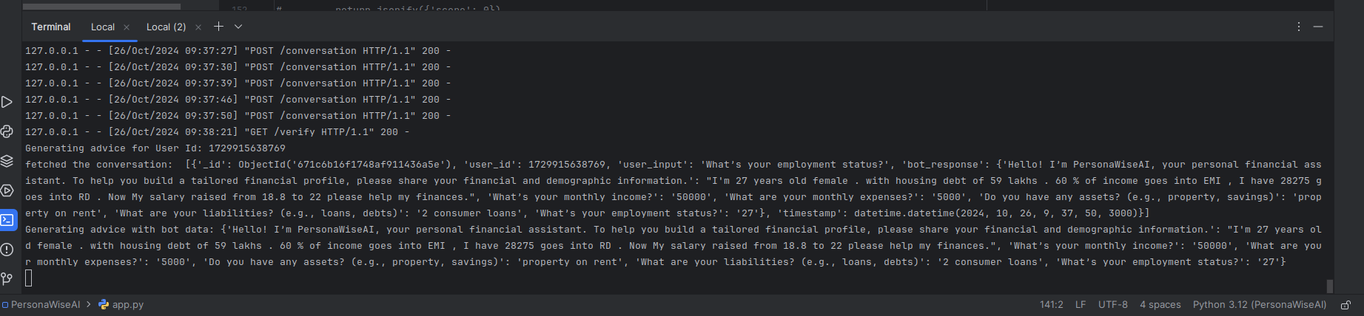
Using Llama to curate financial advice for a persona:

Slide 14
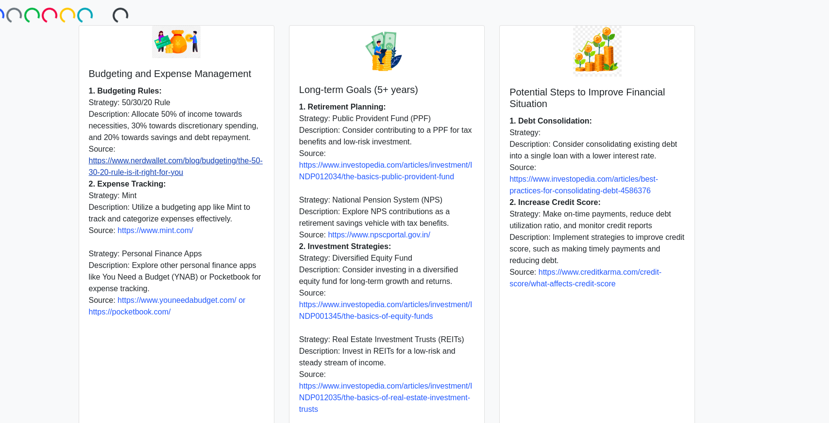
Creating Financial Advice for Persona:

Slide 15






Tech Stack
Frontend Technologies :
HTML, CSS, and JavaScript, Bootstrap
Backend Technologies :
Python , Flask
AI & Data Processing :
LLaMA (Large Language Model) For natural language processing and user input analysis to build financial personas.
Data Storage :
MongoDB

Slide 16
Thank you

